Slide 1

Dr. Sajid Iqbal
Department of Computer Science
Bahauddin Zakariya University, Multan

Slide 2
Statistics for Machine Learning
Probability Theory

Slide 3
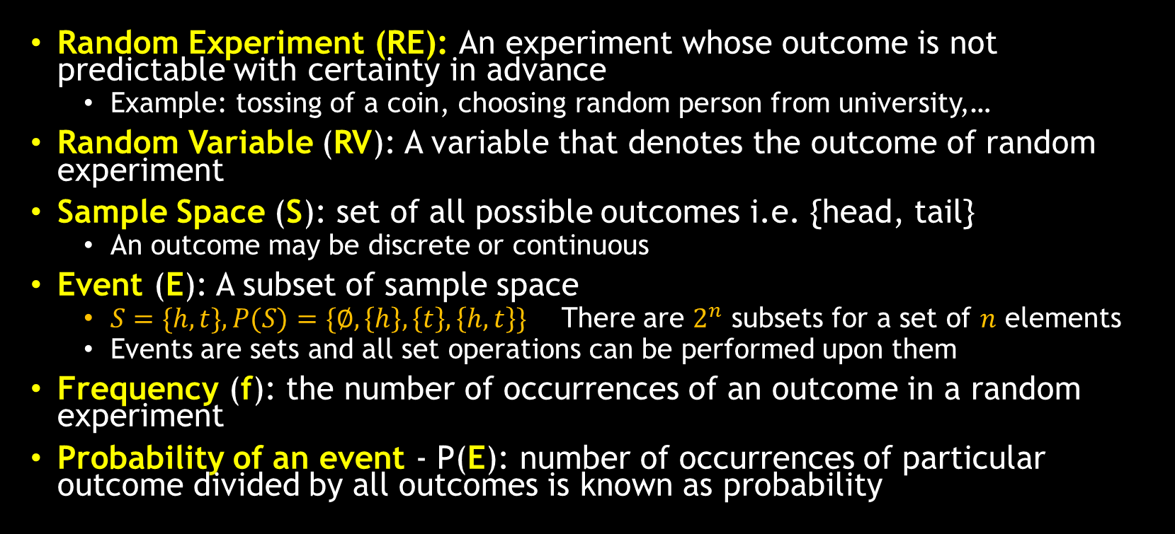
Basic Definitions
Random Experiment (RE): An experiment whose outcome is not predictable with certainty in advance
Example: tossing of a coin, choosing random person from university,…
Random Variable (RV): A variable that denotes the outcome of random experiment
Sample Space (S): set of all possible outcomes i.e. {head, tail}
An outcome may be discrete or continuous
Event (E): A subset of sample space
$S=\{h,t\}, P(S)=\{∅,\left\{h\right\},\left\{t\right\},\left\{h,t\right\}\}$ There are $2^{n}$ subsets for a set of $n$ elements
Events are sets and all set operations can be performed upon them
Frequency (f): the number of occurrences of an outcome in a random experiment
Probability of an event - P(E): number of occurrences of particular outcome divided by all outcomes is known as probability

Slide 4

Basic Definitions
Probability – Coin Tossing
If coin is tossed two times, possible outcomes are
$\{\left(h,h\right),\left(h,t\right),\left(t,h\right),(t,t)\}$
$P\left\{\left(h,t\right)\right\}=\frac{1}{4}$
Probability sometimes is interpreted as a degree of belief
Example
Chances of winning a country in one world cup
Where experiment occurs only once

Slide 5
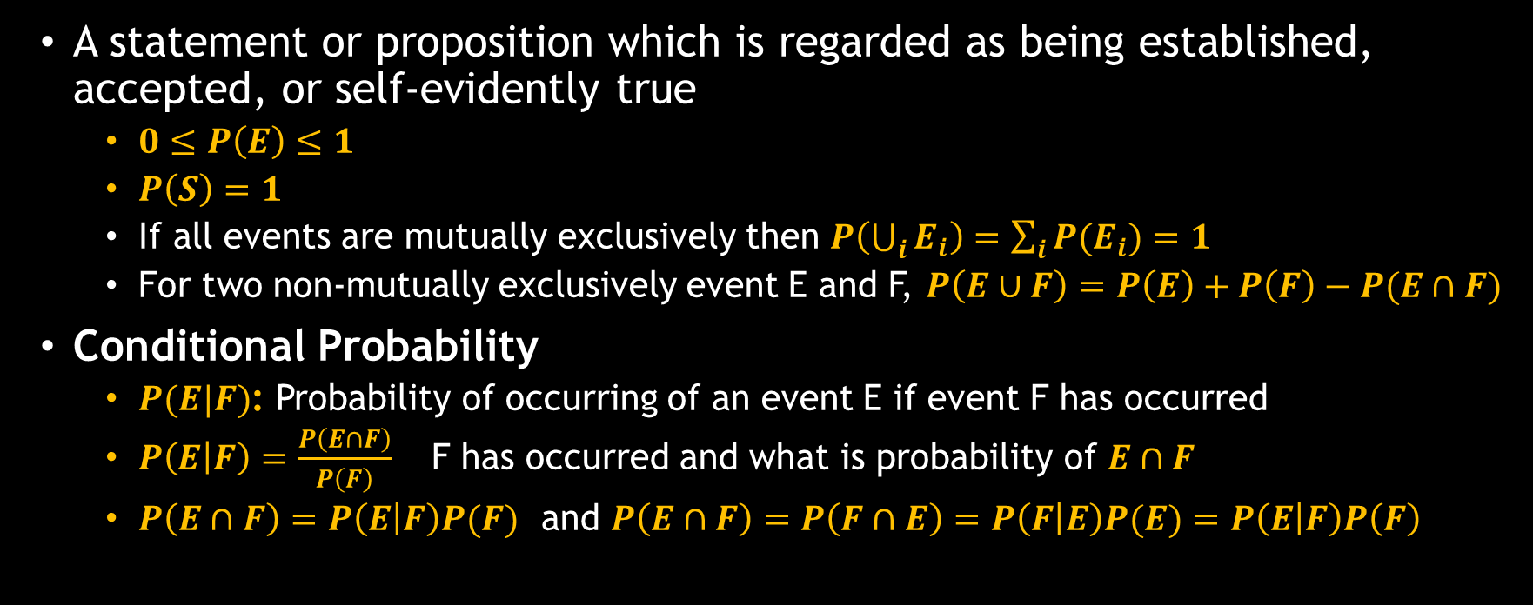
Axioms of Probability
A statement or proposition which is regarded as being established, accepted, or self-evidently true
$\begin{aligned}0≤P\left(E\right)≤1\#\end{aligned}$
$P\left(S\right)=1$
If all events are mutually exclusively then $P\left(\bigcup_{i}{E_{i}}\right)=\sum_{i}{{P(E}_{i})}=1$
For two non-mutually exclusively event E and F, $P\left(E∪F\right)=P\left(E\right)+P\left(F\right)−P(E∩F)$
Conditional Probability
$P(E|F)$: Probability of occurring of an event E if event F has occurred
$P\left(E | F\right)=\frac{P\left(E∩F\right)}{P\left(F\right)}$ F has occurred and what is probability of $E∩F$
$P\left(E∩F\right)=P\left(E | F\right)P(F)$ and $P\left(E∩F\right)=P\left(F∩E\right)=P\left(F | E\right)P(E)=P\left(E | F\right)P\left(F\right)$

Slide 6
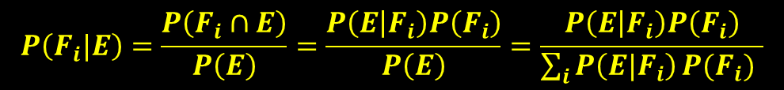
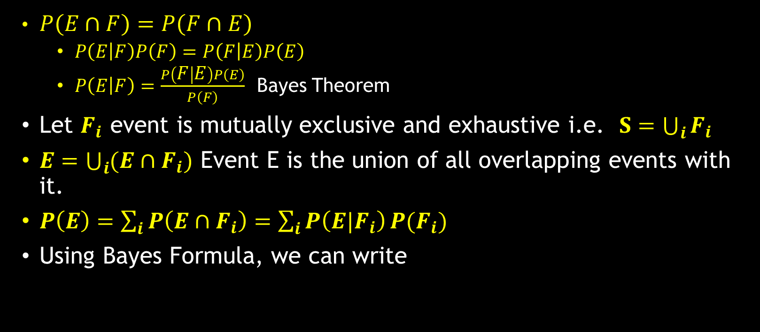
Probability
$\begin{aligned}\begin{aligned}P\left(E∩F\right)=P\left(F∩E\right)\#\end{aligned}\#\end{aligned}$
$P\left(E | F\right)P\left(F\right)=P\left(F | E\right)P\left(E\right)$
$P\left(E | F\right)=\frac{P\left(F | E\right)P\left(E\right)}{P\left(F\right)}$ Bayes Theorem
Let $F_{i}$ event is mutually exclusive and exhaustive i.e. $S=\bigcup_{i}{F_{i}}$
$E=\bigcup_{i}{(E∩F_{i})}$ Event E is the union of all overlapping events with it.
$P\left(E\right)=\sum_{i}{P\left(E∩F_{i}\right)}=\sum_{i}{P\left(E|F_{i}\right)}P(F_{i})$
Using Bayes Formula, we can write
E
$$P\left(F_{i}|E\right)=\frac{P\left(F_{i}∩E\right)}{P\left(E\right)}=\frac{P\left(E | F_{i}\right)P\left(F_{i}\right)}{P\left(E\right)}=\frac{P\left(E | F_{i}\right)P\left(F_{i}\right)}{\sum_{i}{P\left(E|F_{i}\right)}P(F_{i}) }$$

Slide 7
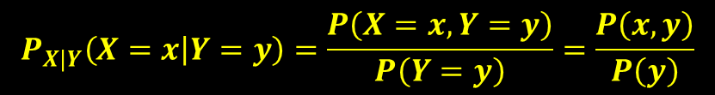
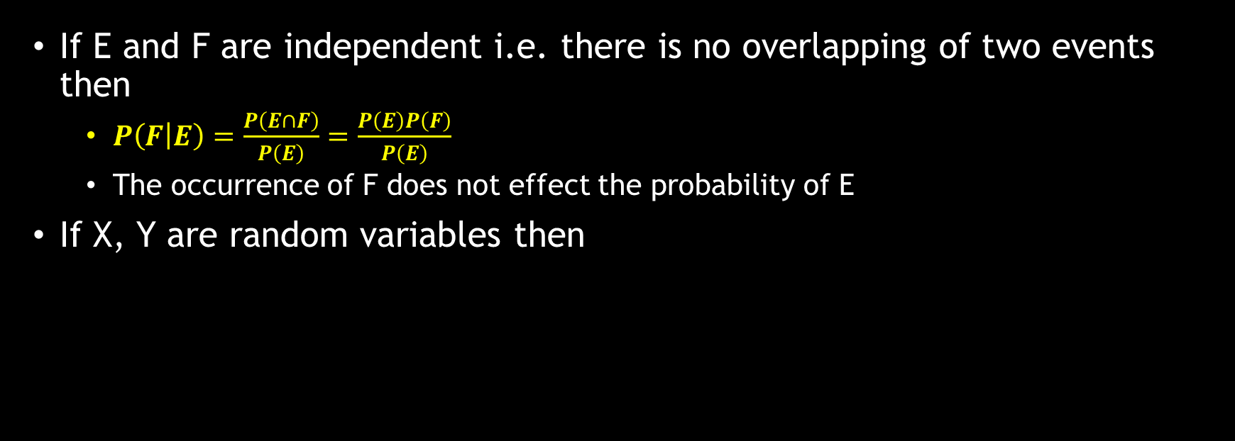
Conditional Distribution
If E and F are independent i.e. there is no overlapping of two events then
$P\left(F | E\right)=\frac{P\left(E∩F\right)}{P\left(E\right)}=\frac{P\left(E\right)P\left(F\right)}{P\left(E\right)}$
The occurrence of F does not effect the probability of E
If X, Y are random variables then
$$P_{X|Y}\left(X=x | Y=y\right)=\frac{P\left(X=x,Y=y\right)}{P\left(Y=y\right)}=\frac{P\left(x,y\right)}{P\left(y\right)}$$

Slide 8
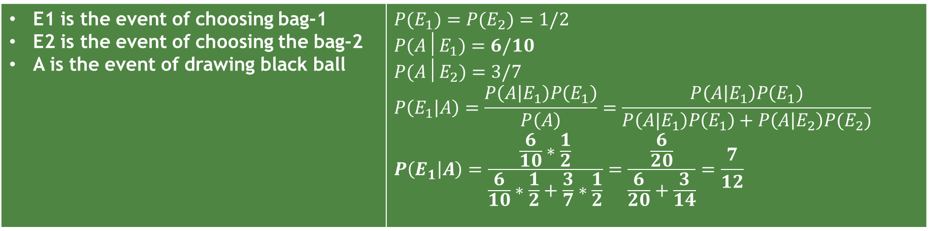
Bayes Theorem Example
Statement
Bag I contains 4-white and 6-black balls. Bag II contains 4-white and 3-black balls. One ball is drawn at random from one of the bags and it is found to be black. Find the probability that it was drawn from Bag I.
Solution
E1 is the event of choosing bag-1 E2 is the event of choosing the bag-2 A is the event of drawing black ball | $$P(E_{1})=P(E_{2})=1/2$$ $$P(A│E_{1})=6/10$$ $$P(A│E_{2})=3/7$$ $$P\left(E_{1} | A\right)=\frac{P\left(A | E_{1}\right)P\left(E_{1}\right)}{P\left(A\right)}=\frac{P\left(A | E_{1}\right)P\left(E_{1}\right)}{P\left(A|E_{1}\right)P\left(E_{1}\right)+P\left(A | E_{2}\right)P(E_{2})}$$ $$P\left(E_{1} | A\right)=\frac{\frac{6}{10}∗\frac{1}{2}}{\frac{6}{10}∗\frac{1}{2}+\frac{3}{7}∗\frac{1}{2}}=\frac{\frac{6}{20}}{\frac{6}{20}+\frac{3}{14}}=\frac{7}{12}$$

Slide 9
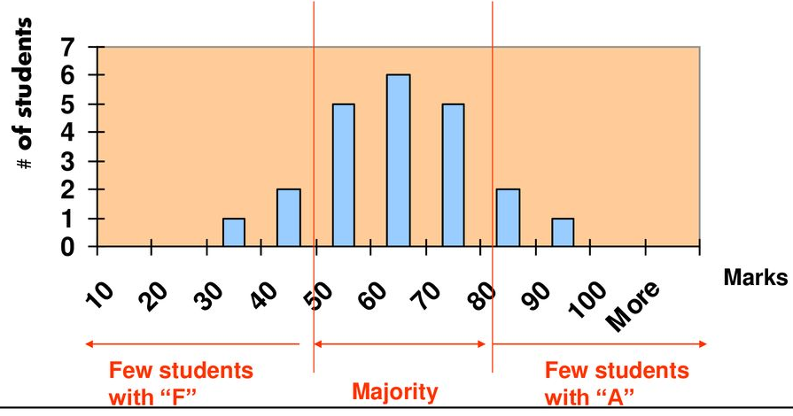
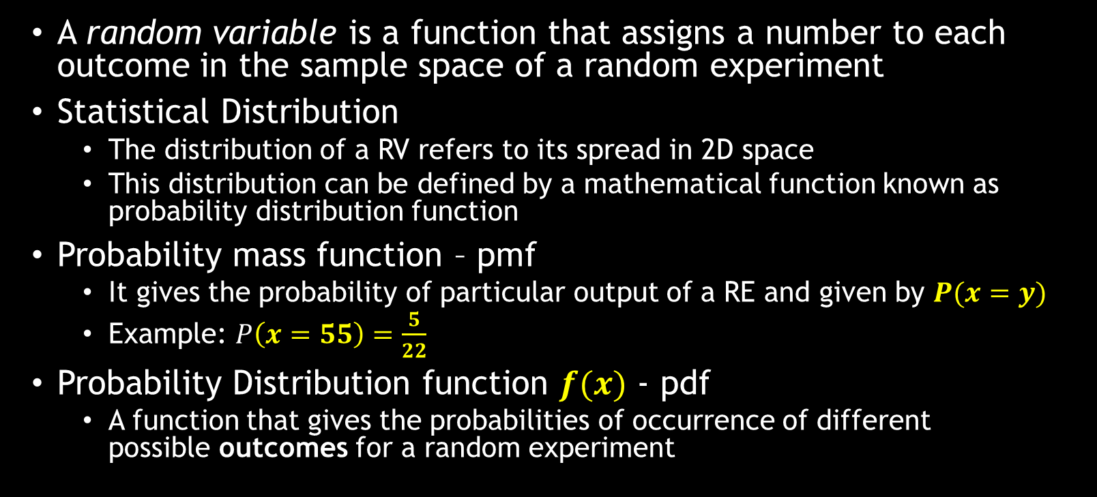
Random Variable
A random variable is a function that assigns a number to each outcome in the sample space of a random experiment
Statistical Distribution
The distribution of a RV refers to its spread in 2D space
This distribution can be defined by a mathematical function known as probability distribution function
Probability mass function – pmf
It gives the probability of particular output of a RE and given by $P(x=y)$
Example: $P\left(x=55\right)=\frac{5}{22}$
Probability Distribution function $f(x)$ - pdf
A function that gives the probabilities of occurrence of different possible outcomes for a random experiment

Slide 10
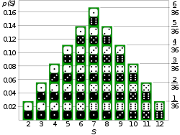
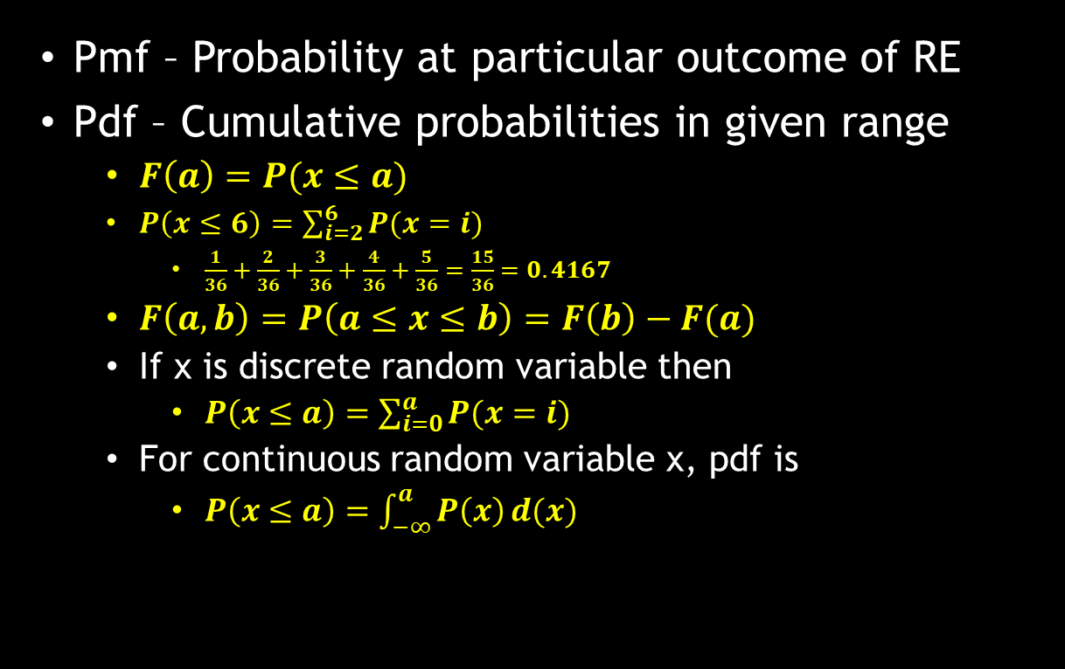
Probability Distribution
Pmf – Probability at particular outcome of RE
Pdf – Cumulative probabilities in given range
$F\left(a\right)=P(x≤a)$
$P\left(x≤6\right)=\sum_{i=2}^{6}{P(x=i)}$
$\frac{1}{36}+\frac{2}{36}+\frac{3}{36}+\frac{4}{36}+\frac{5}{36}=\frac{15}{36}=0.4167$
$F\left(a,b\right)=P\left(a≤x≤b\right)=F\left(b\right)−F(a)$
If x is discrete random variable then
$P\left(x≤a\right)=\sum_{i=0}^{a}{P(x=i)}$
For continuous random variable x, pdf is
$P\left(x≤a\right)=\int_{−∞}^{a}{P\left(x\right)}d(x)$

Slide 11
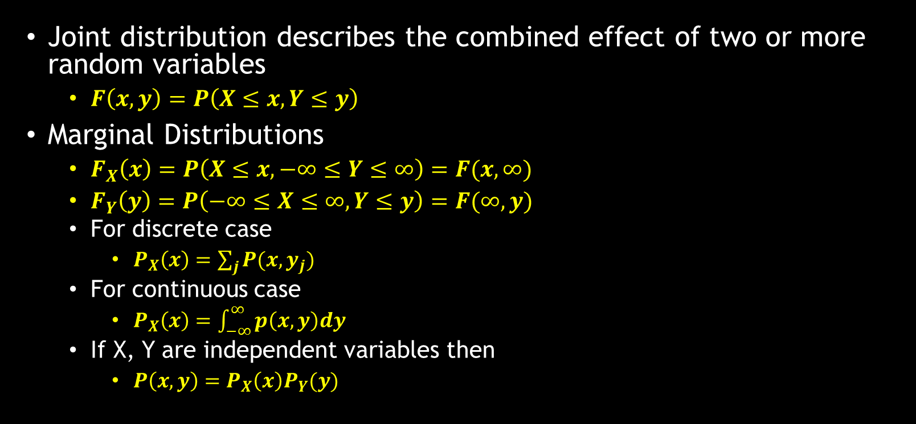
Joint Distribution and Density Functions
Joint distribution describes the combined effect of two or more random variables
$F\left(x,y\right)=P\left(X≤x,Y≤y\right)$
Marginal Distributions
$F_{X}\left(x\right)=P\left(X≤x,−∞≤Y≤∞\right)=F(x,∞)$
$F_{Y}\left(y\right)=P\left(−∞≤X≤∞,Y≤y\right)=F(∞,y)$
For discrete case
$P_{X}\left(x\right)=\sum_{j}{P(x,y_{j})}$
For continuous case
$P_{X}\left(x\right)=\int_{−∞}^{∞}{p\left(x,y\right)dy}$
If X, Y are independent variables then
$P\left(x,y\right)=P_{X}\left(x\right)P_{Y}(y)$

Slide 12
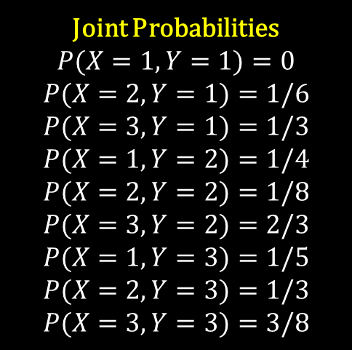
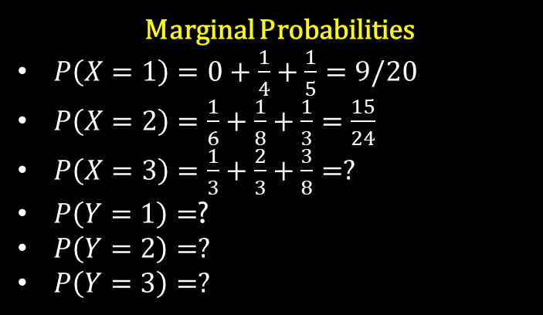
Joint Probabilities
$$P(X=1,Y=1)=0$$
$$P(X=2,Y=1)=1/6$$
$$P(X=3,Y=1)=1/3$$
$$P(X=1,Y=2)=1/4$$
$$P(X=2,Y=2)=1/8$$
$$P(X=3,Y=2)=2/3$$
$$P(X=1,Y=3)=1/5$$
$$P(X=2,Y=3)=1/3$$
$$P(X=3,Y=3)=3/8$$
Marginal Probabilities
$P\left(X=1\right)=0+\frac{1}{4}+\frac{1}{5}=9/20$
$P\left(X=2\right)=\frac{1}{6}+\frac{1}{8}+\frac{1}{3}=\frac{15}{24}$
$P\left(X=3\right)=\frac{1}{3}+\frac{2}{3}+\frac{3}{8}=?$
$P\left(Y=1\right)=$?
$P\left(Y=2\right)=?$
$P\left(Y=3\right)=?$
x
y |  | 1 | 2 | 3
 | 1 | 0 | 1/6 | 1/3
 | 2 | ¼ | 1/8 | 2/3
 | 3 | 1/5 | 1/3 | 3/8
More about joint probability distribution…
Notes:
https://ocw.mit.edu/courses/mathematics/18-05-introduction-to-probability-and-statistics-spring-2014/readings/MIT18_05S14_Reading7a.pdf

Slide 13
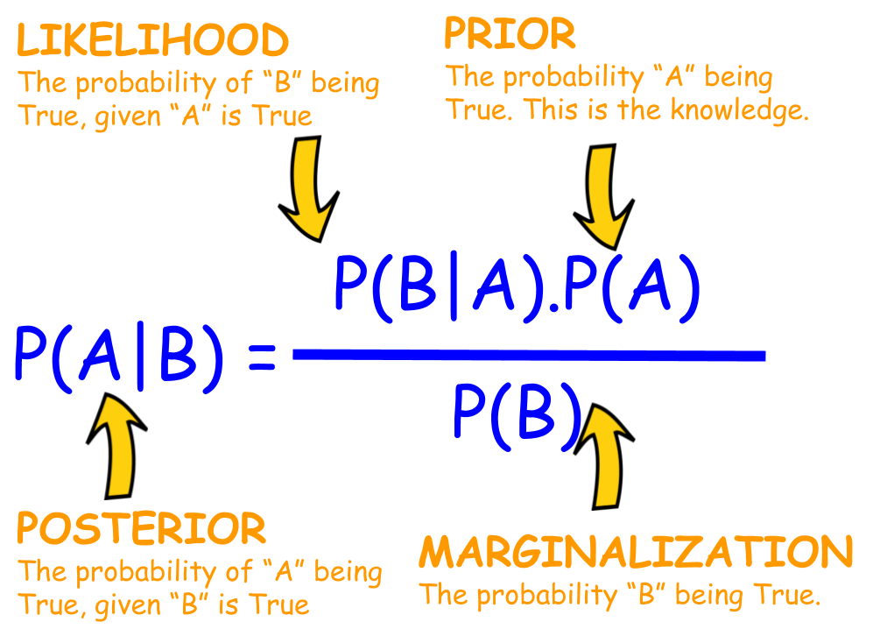
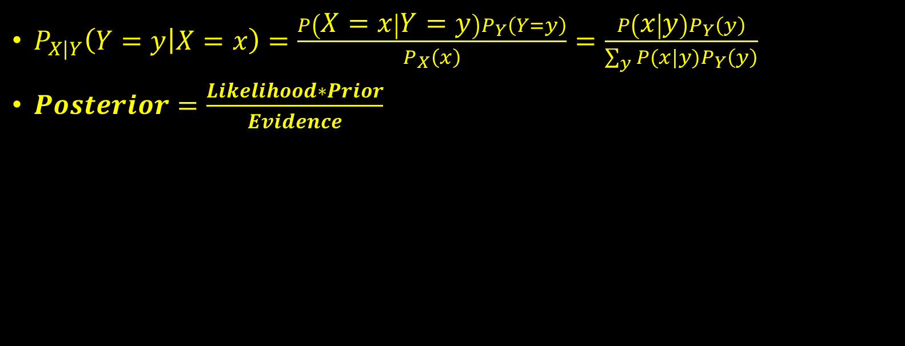

Bayes’ Rule
$P_{X|Y}\left(Y=y | X=x\right)=\frac{P\left(X=x | Y=y\right)P_{Y}\left(Y=y\right)}{P_{X}\left(x\right)}=$ $\frac{P\left(x | y\right)P_{Y}\left(y\right)}{\sum_{y}{P(x|y)}P_{Y}\left(y\right)}$
$Posterior=\frac{Likelihood∗Prior}{Evidence}$
$P\left(cancer | +\right)=\frac{P\left(+ | cancer\right)P\left(cancer\right)}{P\left(+\right)}$

Slide 14
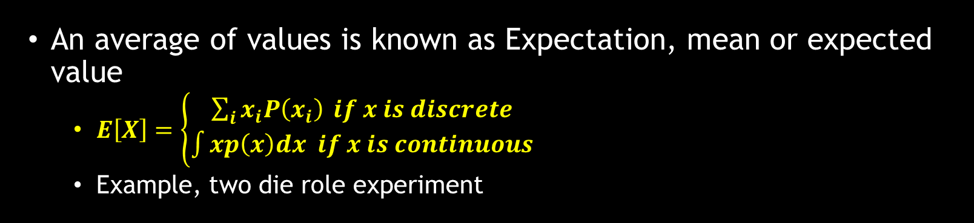
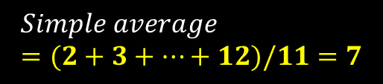
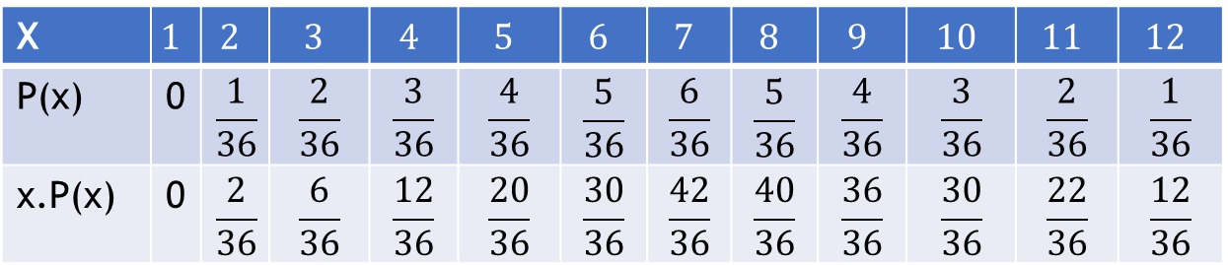
Expectation
An average of values is known as Expectation, mean or expected value
$E\left[X\right]=\left\{\begin{aligned}\sum_{i}{x_{i}P\left(x_{i}\right)} if x is discrete \\ \int{xp\left(x\right)dx if x is continuous}\end{aligned}\right.$
Example, two die role experiment
X | $$1$$ | $$2$$ | $$3$$ | $$4$$ | $$5$$ | $$6$$ | $$7$$ | $$8$$ | $$9$$ | $$10$$ | $$11$$ | $$12$$
P(x) | 0 | $$\frac{1}{36}$$ | $$\frac{2}{36}$$ | $$\frac{3}{36}$$ | $$\frac{4}{36}$$ | $$\frac{5}{36}$$ | $$\frac{6}{36}$$ | $$\frac{5}{36}$$ | $$\frac{4}{36}$$ | $$\frac{3}{36}$$ | $$\frac{2}{36}$$ | $$\frac{1}{36}$$
x.P(x) | 0 | $$\frac{2}{36}$$ | $$\frac{6}{36}$$ | $$\frac{12}{36}$$ | $$\frac{20}{36}$$ | $$\frac{30}{36}$$ | $$\frac{42}{36}$$ | $$\frac{40}{36}$$ | $$\frac{36}{36}$$ | $$\frac{30}{36}$$ | $$\frac{22}{36}$$ | $$\frac{12}{36}$$
$$E\left[X\right]=\frac{1}{36}\left(2+6+12+20+30+42+40+36+30+22+12\right)=\frac{252}{36}=7$$
$$Simple average=(2+3+…+12)/11=7$$

Slide 15
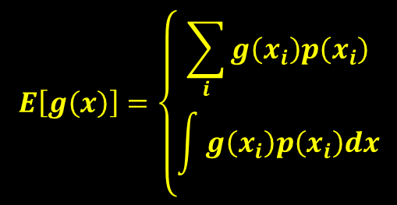
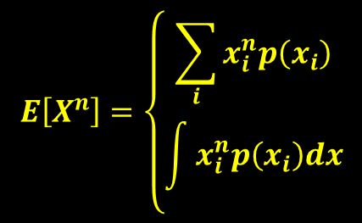


Properties of Expectation
$$E\left[g\left(x\right)\right]=\left\{\begin{aligned}\sum_{i}{g\left(x_{i}\right)p\left(x_{i}\right)} \\ \int{g\left(x_{i}\right)p\left(x_{i}\right)dx}\end{aligned}\right.$$
$$E\left[aX\right]+b=aE\left[X\right]+b$$
$$E\left[X^{n}\right]=\left\{\begin{aligned}\sum_{i}{x_{i}^{n}p\left(x_{i}\right)} \\ \int{x_{i}^{n}p\left(x_{i}\right)dx}\end{aligned}\right.$$
$$E\left[X+Y\right]=E\left[X\right]+E\left[Y\right]$$

Slide 16
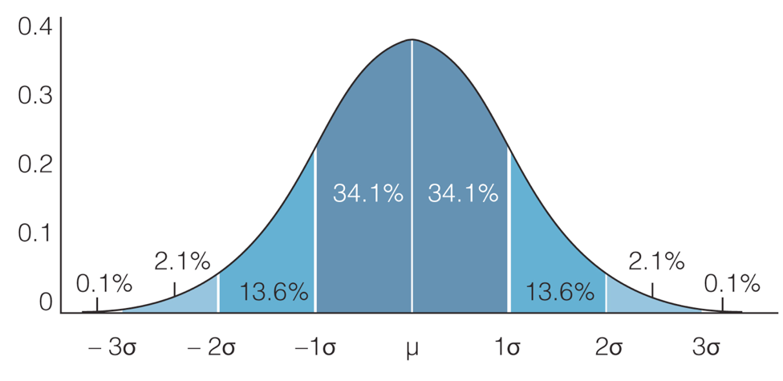
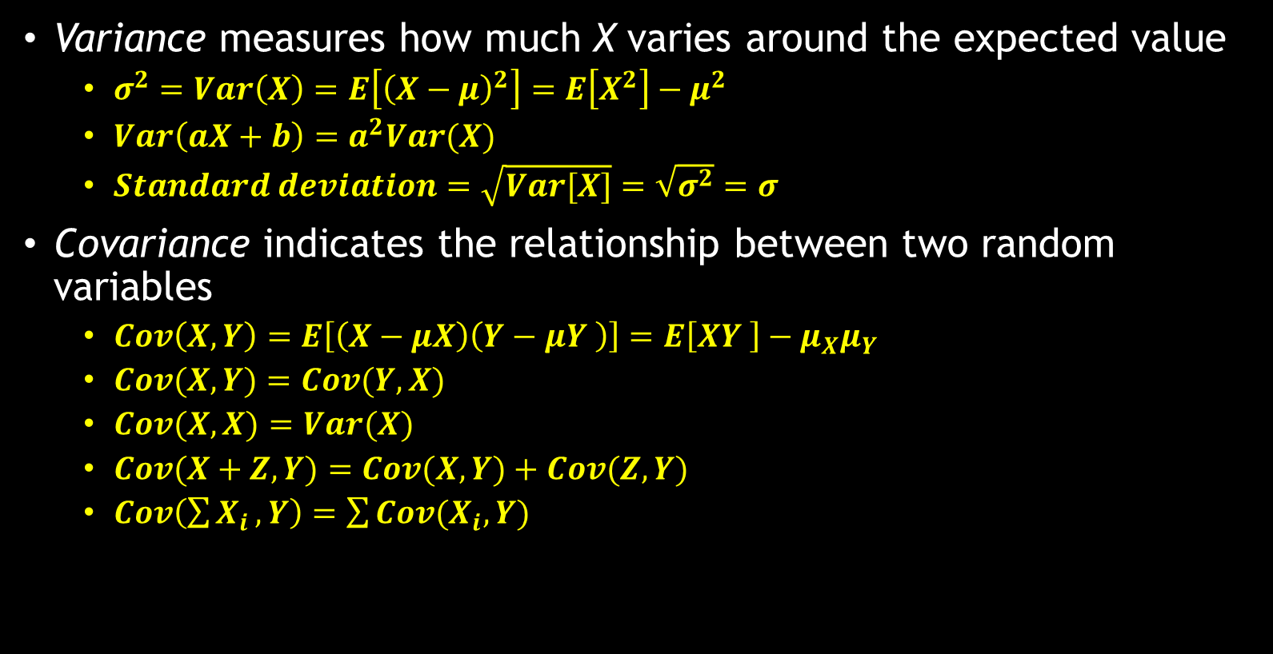
Variance
Variance measures how much X varies around the expected value
$σ^{2}=Var\left(X\right)=E\left[{\left(X−μ\right)}^{2}\right]=E\left[X^{2}\right]−μ^{2}$
$Var\left(aX+b\right)=a^{2}Var(X)$
$Standard deviation=\sqrt{Var[X]}=\sqrt{σ^{2}}=σ$
Covariance indicates the relationship between two random variables
$Cov\left(X, Y\right)=E\left[\left(X−μX\right)\left(Y−μY \right)\right]=E\left[XY \right]−μ_{X}μ_{Y}$
$Cov(X, Y)=Cov(Y, X)$
$Cov(X,X)=Var(X)$
$Cov(X+Z,Y)=Cov(X,Y)+Cov(Z,Y)$
$Cov\left(\sum{X_{i}},Y\right)=\sum{Cov(X_{i},Y)}$

Slide 17
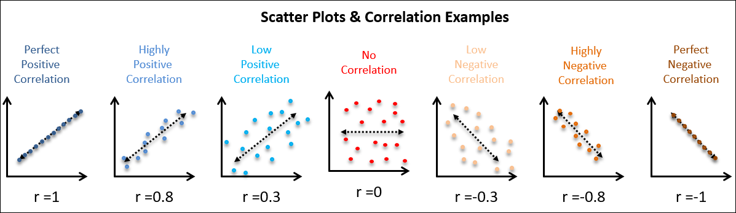
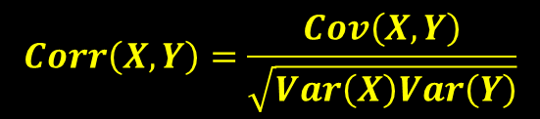
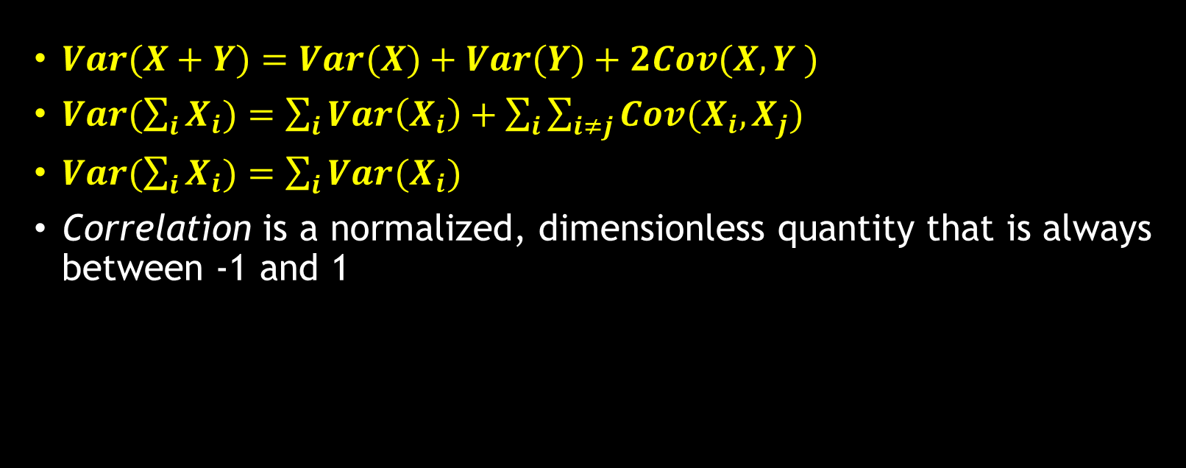
Variance
$Var(X+Y)=Var(X)+Var(Y)+2Cov(X, Y )$
$Var(\sum_{i}{X_{i})=\sum_{i}{Var\left(X_{i}\right)}+\sum_{i}{\sum_{i≠j}{Cov(X_{i},X_{j})}}}$
$Var(\sum_{i}{X_{i})=\sum_{i}{Var(X_{i})}}$
Correlation is a normalized, dimensionless quantity that is always between -1 and 1
$$Corr\left(X,Y\right)=\frac{Cov\left(X,Y\right)}{\sqrt{Var\left(X\right)Var\left(Y\right)}}$$

Slide 18

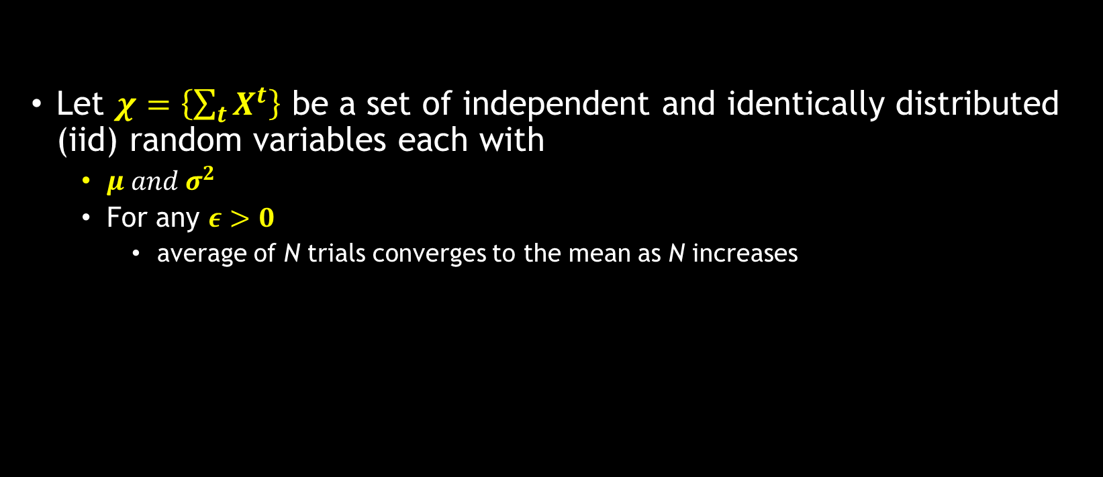
Weak Law of Large Numbers
Let $χ=\left\{\sum_{t}{X^{t}}\right\}$ be a set of independent and identically distributed (iid) random variables each with
$μ and σ^{2}$
For any $ε>0$
average of N trials converges to the mean as N increases
$$P\left\{\left|\frac{\sum_{t}{X^{t}}}{N}−μ\right|>ε\}\right.→0 and N→∞$$

Slide 19
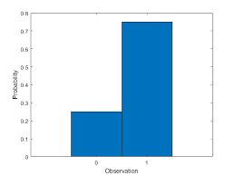
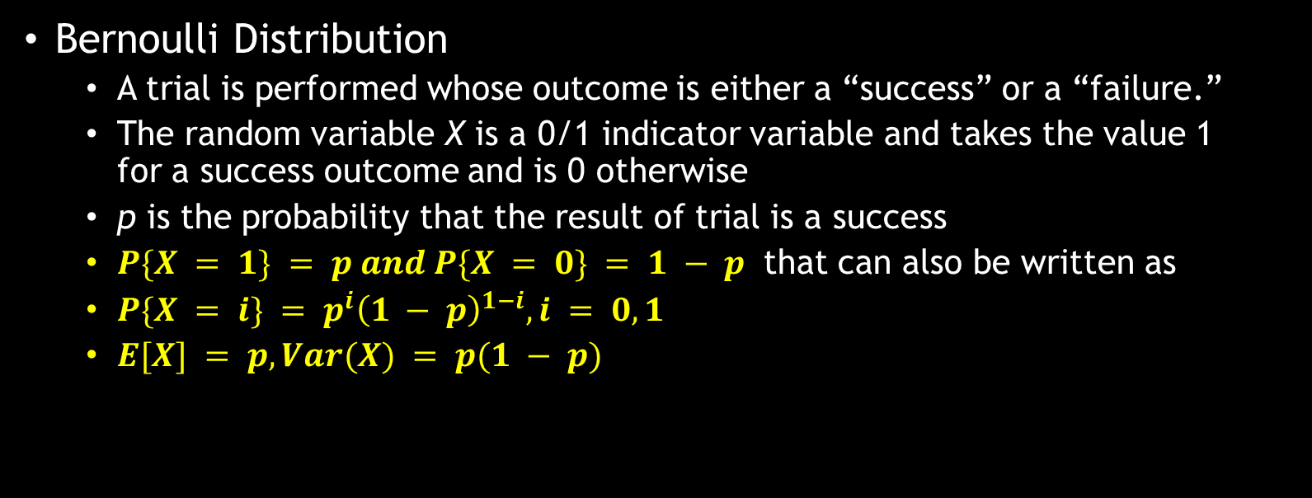
Special Random Variables
Bernoulli Distribution
A trial is performed whose outcome is either a “success” or a “failure.”
The random variable X is a 0/1 indicator variable and takes the value 1 for a success outcome and is 0 otherwise
p is the probability that the result of trial is a success
$P\{X = 1\} = p and P\{X = 0\} = 1 − p$ that can also be written as
$P\{X = i\} = p^{i}{\left(1 − p\right)}^{1−i}, i = 0, 1$
$E[X] = p, Var(X) = p(1 − p)$

Slide 20
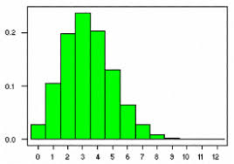
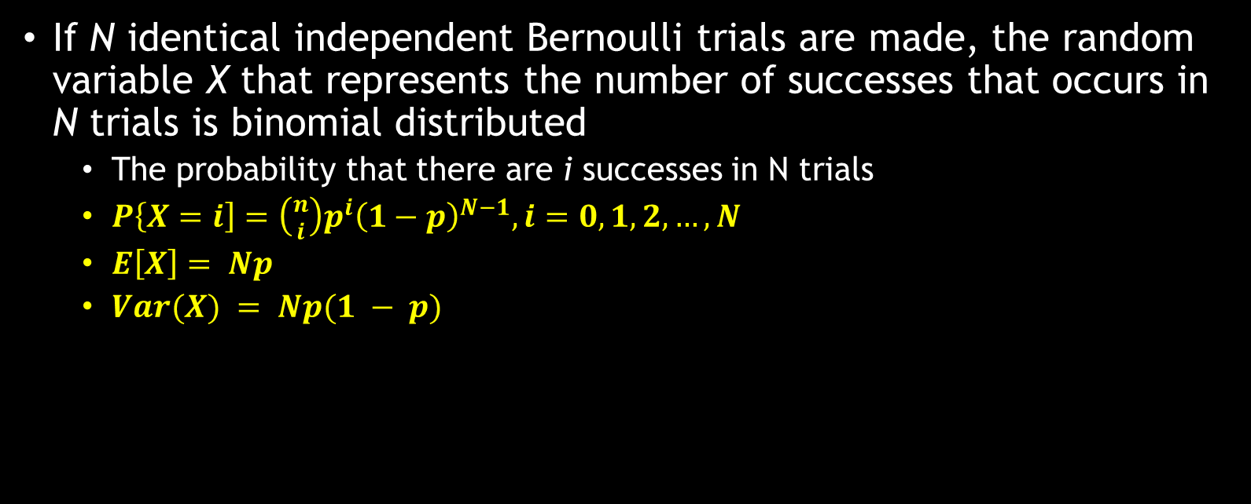
Binomial Distribution
If N identical independent Bernoulli trials are made, the random variable X that represents the number of successes that occurs in N trials is binomial distributed
The probability that there are i successes in N trials
$P\left\{X=i\right]=\left({n \atop i}\right)p^{i}{\left(1−p\right)}^{N−1}, i=0,1,2,…,N$
$E\left[X\right]= Np$
$Var(X) = Np(1 − p)$

Slide 21
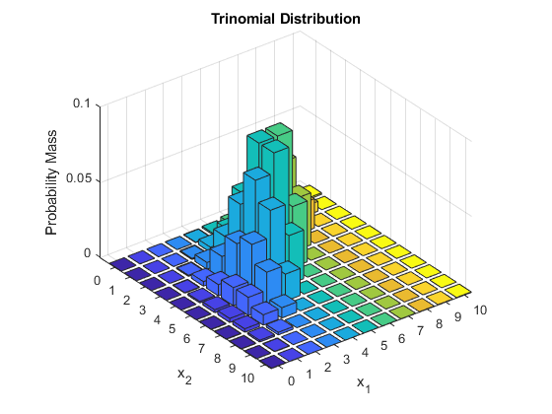

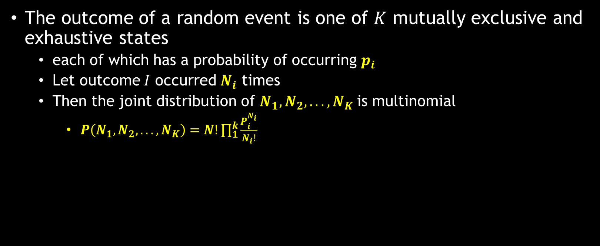
Multinomial Distribution
The outcome of a random event is one of $K$ mutually exclusive and exhaustive states
each of which has a probability of occurring $p_{i}$
Let outcome $I$ occurred $N_{i}$ times
Then the joint distribution of $N_{1}, N_{2}, . . . , N_{K}$is multinomial
$P\left(N_{1}, N_{2}, . . . , N_{K}\right)=N!\prod_{1}^{k}{\frac{P_{i}^{N_{i}}}{N_{i}!}}$
A special case is when N = 1; only one trial is made
$P\left(N_{1}, N_{2}, . . . , N_{K}\right)=N!\prod_{1}^{k}{\frac{P_{i}^{N_{i}}}{1}}$

Slide 22
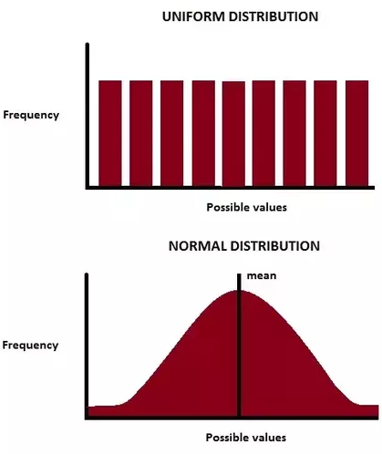
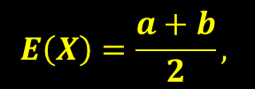
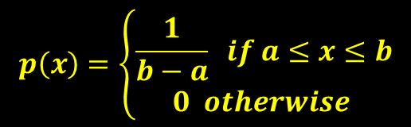
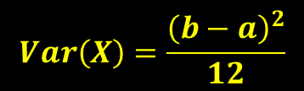
Uniform Distribution
X is uniformly distributed over the interval [a, b] if its density function is given by
$$p\left(x\right)=\left\{\begin{aligned}\frac{1}{b−a} if a≤x≤b \\ 0 otherwise \end{aligned}\right.$$
$$E\left(X\right)=\frac{a+b}{2},$$
$$Var\left(X\right)=\frac{{\left(b−a\right)}^{2}}{12}$$

Slide 23
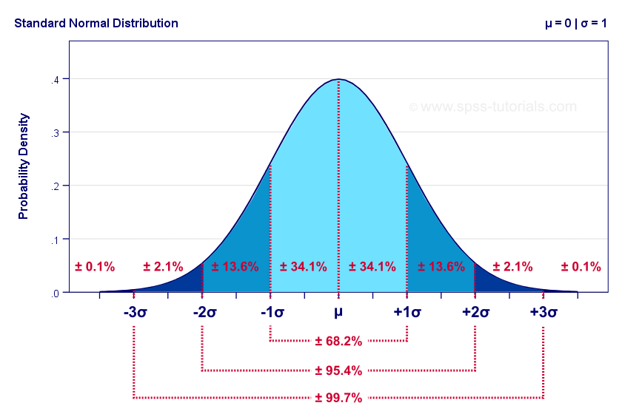
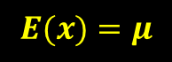
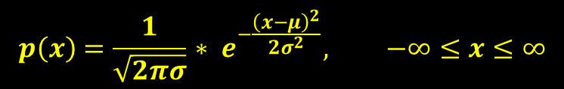

Normal/Gaussian Distribution
$$p\left(x\right)=\frac{1}{\sqrt{2πσ}}{ ∗ e}^{−\frac{{\left(x−μ\right)}^{2}}{2σ^{2}}}, −∞≤x≤∞$$
$$E(x)=μ$$
$$Variance=σ^{2}$$

Slide 24
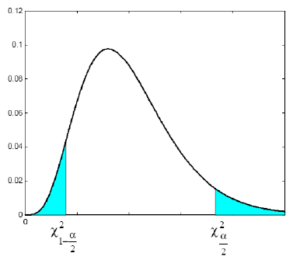
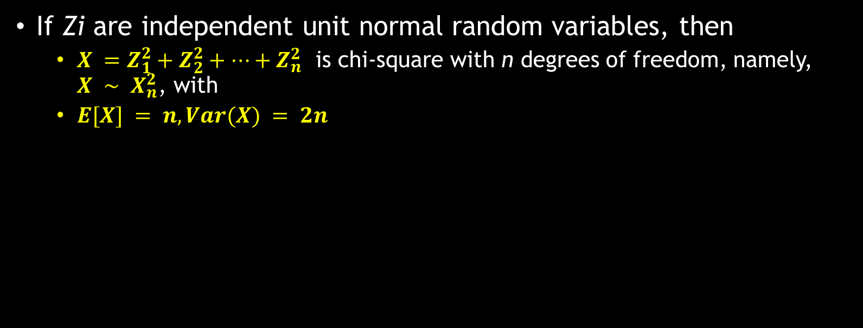
Chi-Square Distribution
If Zi are independent unit normal random variables, then
$X =Z_{1}^{2}+Z_{2}^{2}+…+Z_{n}^{2}$ is chi-square with n degrees of freedom, namely, $X ∼ X_{n}^{2}$, with
$E[X] = n, Var(X) = 2n$

Slide 25
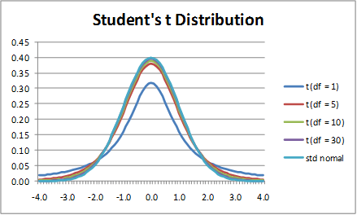
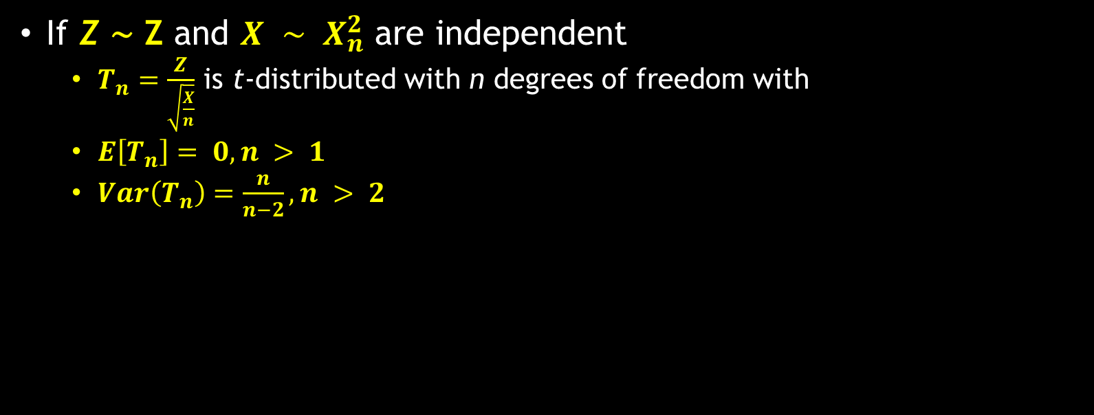
t-Distribution
If Z ∼ Z and $X ∼ X_{n}^{2}$ are independent
$T_{n}=\frac{Z}{\sqrt{\frac{X}{n}}}$ is t-distributed with n degrees of freedom with
$E\left[T_{n}\right]= 0, n > 1$
$Var\left(T_{n}\right)=\frac{n}{n−2}, n > 2$

Slide 26
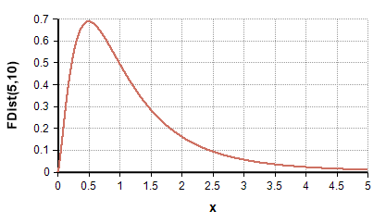
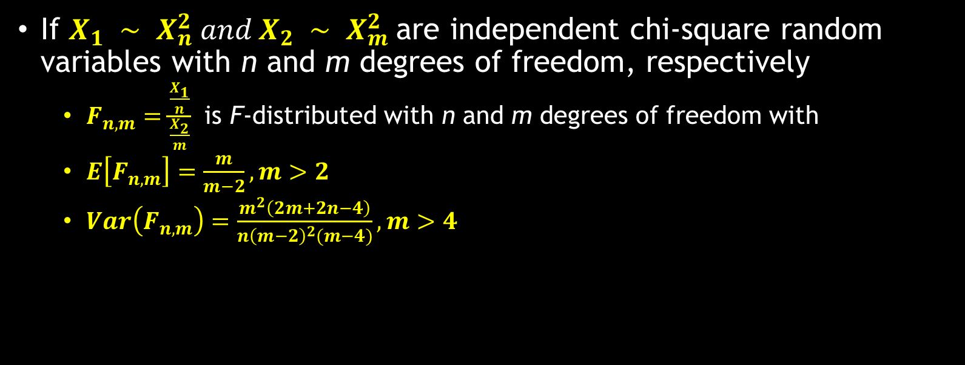
F Distribution
If $X_{1} ∼ X_{n}^{2} and X_{2} ∼ X_{m}^{2}$are independent chi-square random variables with n and m degrees of freedom, respectively
$F_{n,m}=\frac{\frac{X_{1}}{n}}{\frac{X_{2}}{m}}$ is F-distributed with n and m degrees of freedom with
$E\left[F_{n,m}\right]=\frac{m}{m−2}, m>2$
$Var\left(F_{n,m}\right)=\frac{m^{2}\left(2m+2n−4\right)}{n{\left(m−2\right)}^{2}(m−4)}, m>4$

Slide 27
Assignment-2
Write the python program to
Calculate simple probability from given data
Conditional probability
Pmf, pdf
Joint probability distribution, marginal probability distribution
Calculate the expectation and variance of given distribution
Using numpy library, you can generate random data of specified distribution
Create the set of values of user specified distribution
Find its mean, variance, standard deviation and plot it

Slide 28



Thanks for watching
Dr. Sajid Iqbal
Assistant Professor
Department of Computer Science
Bahauddin Zakariya University, Multan
sajidiqbal.pk@gmail.com
https://github.com/sajjo79/Design_and_Analysis_of_Algorithms
Allah Hafiz
COMEDXD

